Slide 1
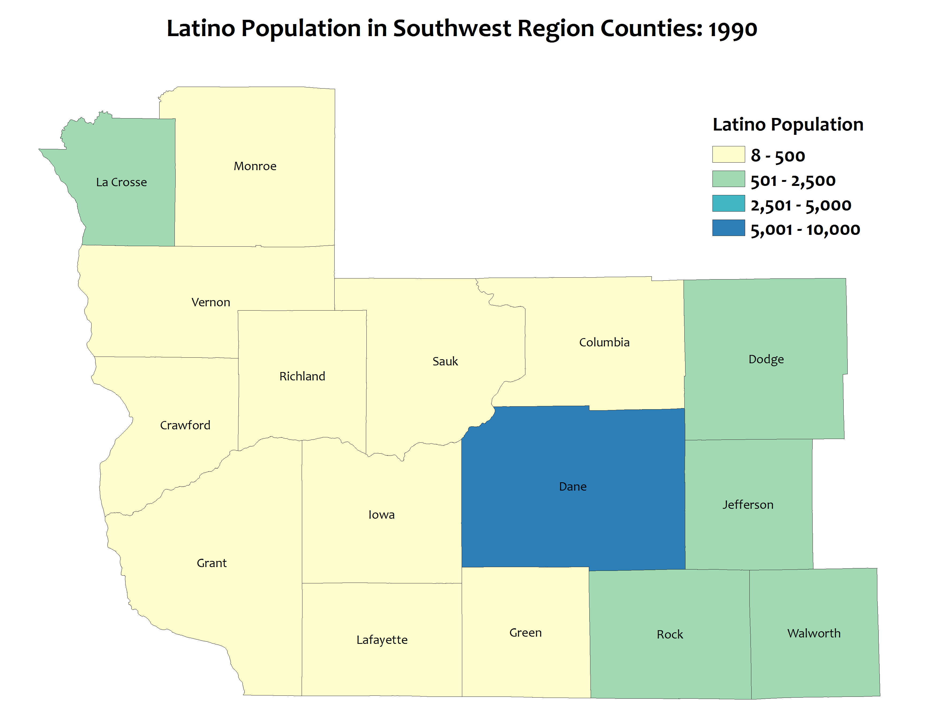
Rapid Latino population growth: 1990
1990 total for region = 13,613
Notes:
Total Latino Population in SW Region counties
Map shows total Latino population by county for SW region counties. The blue and darker blue represent higher total populations while the yellow or green represent lower populations
As you advance through the decades, more counties turn green or blue. Dane County will turn gray because it has a much larger Latino population than any other county in the region
This map is 1990. 6 of the counties in the region have more than 500 Latinos

Slide 2
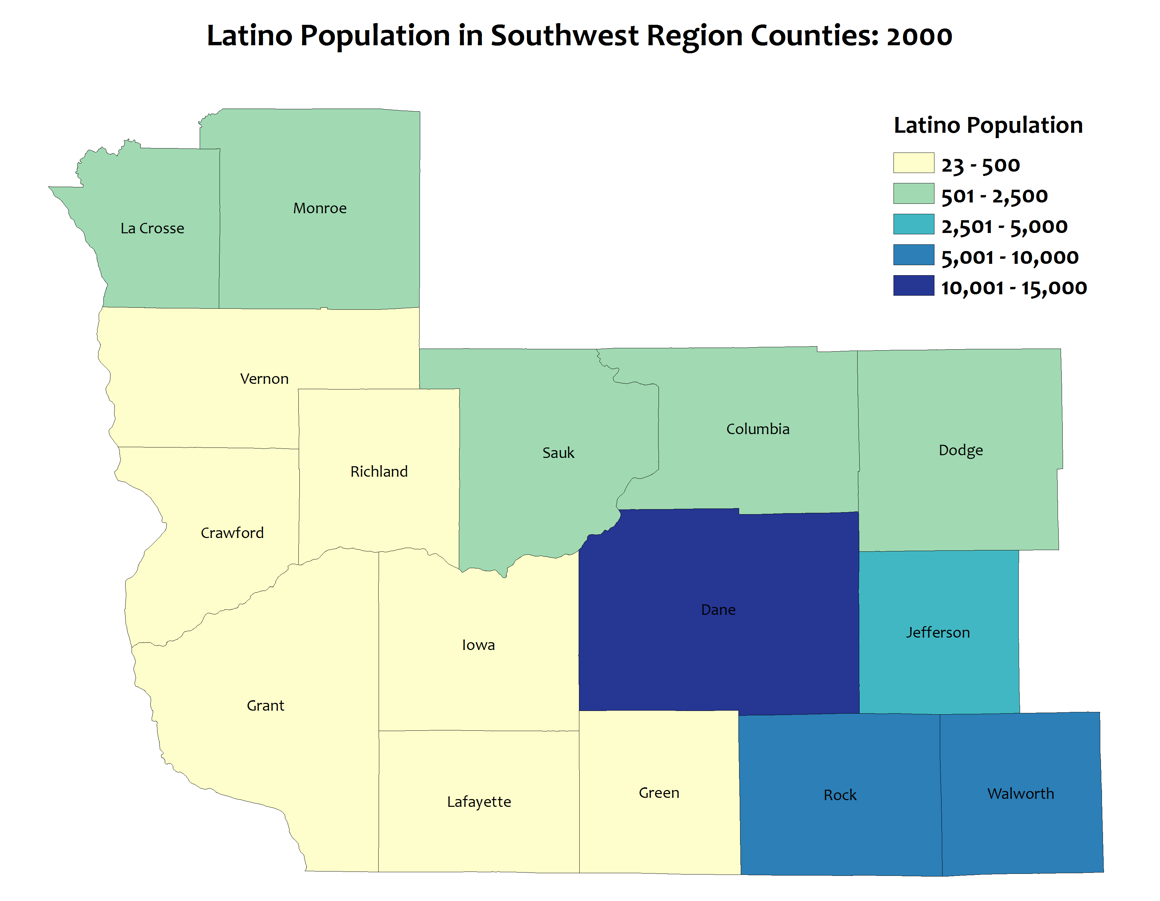
Rapid Latino population growth: 2000
1990 total for region = 13,613
2000 total for region = 36,446
Notes:
This map is 2000. A lot of Latino population increase in Dane, Rock, Walworth
In 2000, 9 counties have more than 5000 Latinos and 4 counties have more than 2,500 Latinos

Slide 3
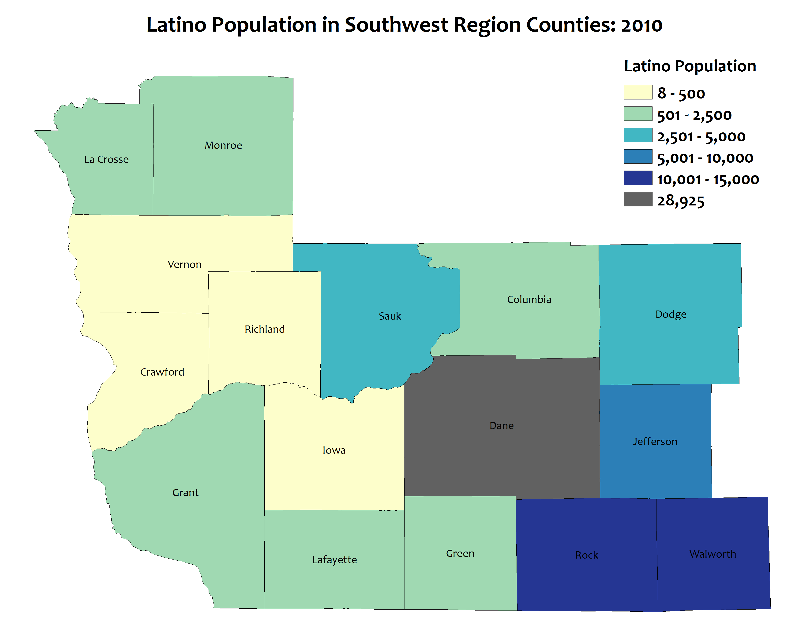
Rapid Latino population growth: 2010
1990 total for region = 13,613
2000 total for region = 36,446
2010 total for region = 71,669
Notes:
Total Latino Population in SW Region counties
This map is 2010. 12 of the 16 counties in the region have more than 500 Latinos

Slide 4
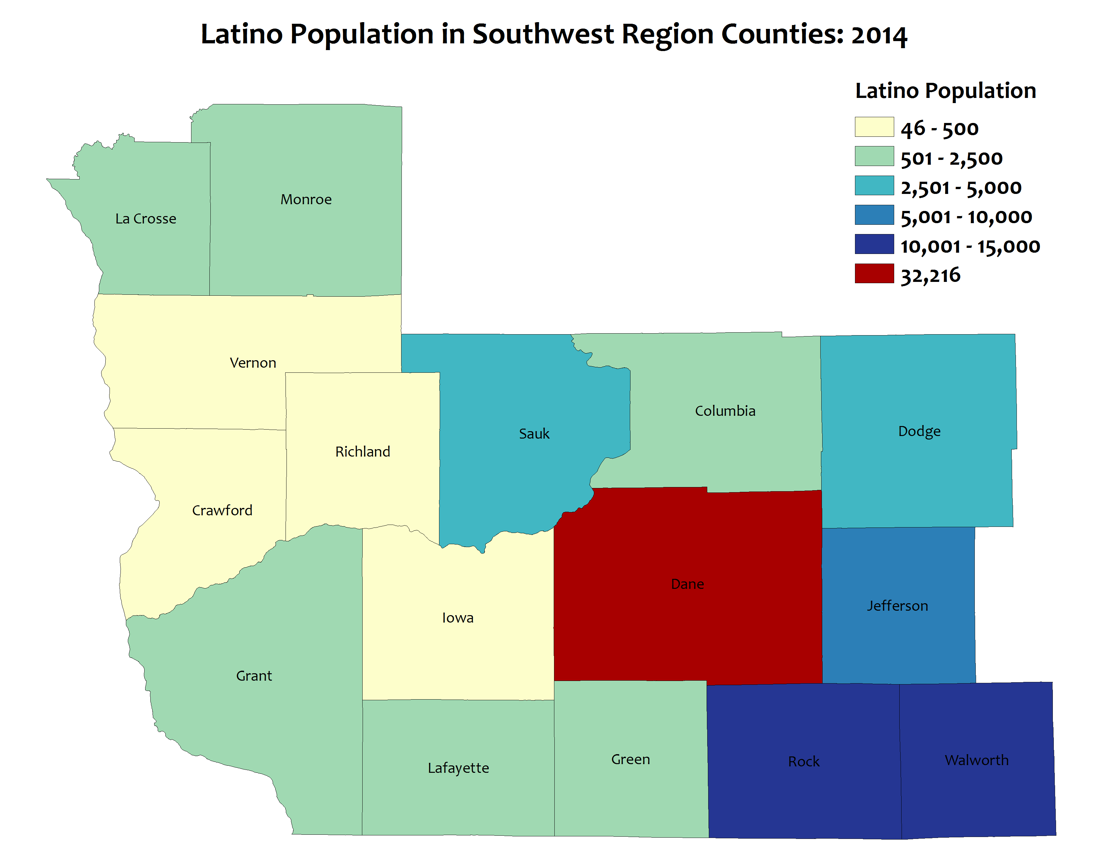
Rapid Latino population growth: 2014
1990 total for region = 13,613
2000 total for region = 36,446
2010 total for region = 71,669
2014 total for region = 79,424
Notes:
Total Latino Population in SW Region counties
This map is 2014 (the most recent data available). 12 of the 16 counties in the region have more than 500 Latinos. The combined population for the 16 counties has risen to over 79,000
Latino population has gone from about 14,000 in 1990 to more than 79,000 in 2014 – an increase of 65,000 (483%). In other words, the Latino population has almost quintupled over a 25 year period.
The rate of growth is faster than the East-Metro and the North Central Regions and is about the same as the Northwest.
40% of Latinos in the SW Region live in Dane County
About 21% of Wisconsin’s Latinos live in the SW Region counties.

Slide 5
The Latino population is very young
34,730 were under age 20
31,973 were age 20-44
Notes:
Population by Age
This chart compares the Latino population to the total population for major age groupings for the SW Region counties. The Latino population is much, much younger than the total population. The green columns are the total population and the blue columns are the Latino population.
About 2 out of 5 Latinos in the region are under the age of 20.
More than 80% are age 44 and under.
Two extra clicks will bring in the boxes showing the number totals.

Slide 6
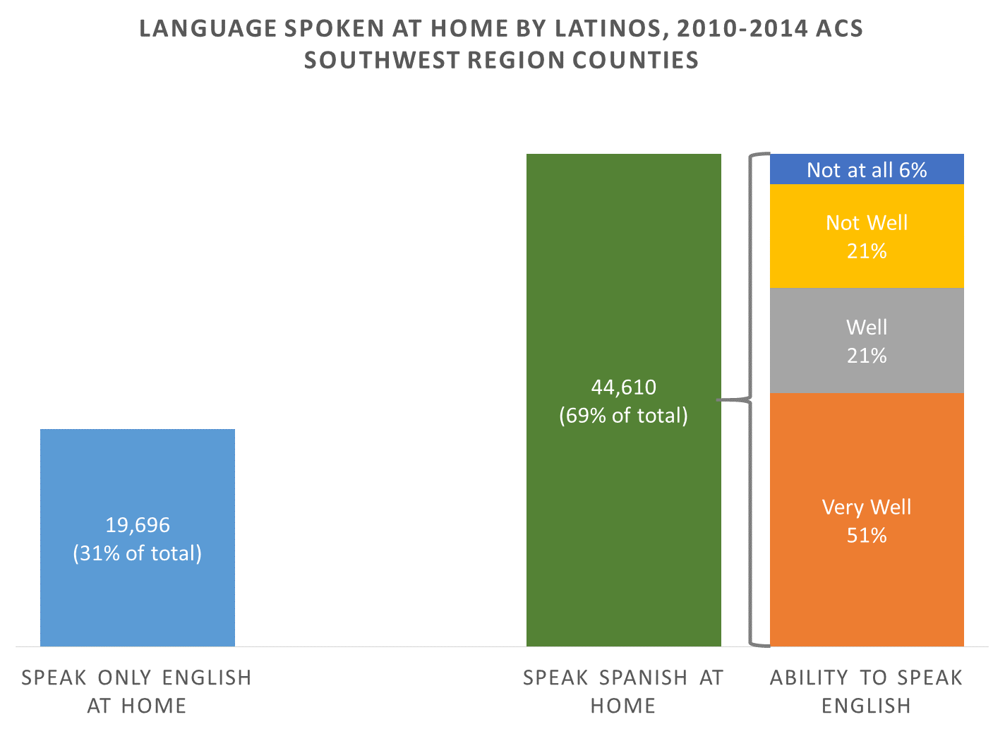
Many Latinos speak Spanish and English
For those who speak Spanish at home….
Notes:
Language spoken at home for Latino population age 5 and over
This chart shows data on language spoken at and ability to speak English for Latinos age 5 and over in the SW Region counties.
About 1/3rd of Latinos in the SW Region counties speak only English at home.
About 72% of Latinos who speak Spanish at home also speak English “well” or “very well”
Data comes from the 2010-2014 American Community Survey 5-year estimates. All estimates in the ACS are based on survey responses and so language spoken at home and ability to speak English are self-reported by respondents.

