Slide 1
“Strengthening Outreach to Latino Populations in the East Metro Region”
Latino Employee Resource Group (LERG)
March 14, 2016

Slide 2
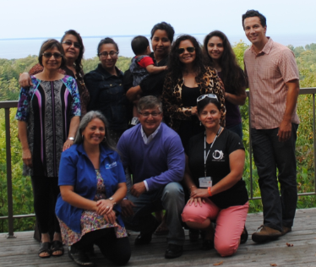
UWEX Latino Employees Resources Group
(LERG)
Vision
Mission
Values

Slide 3
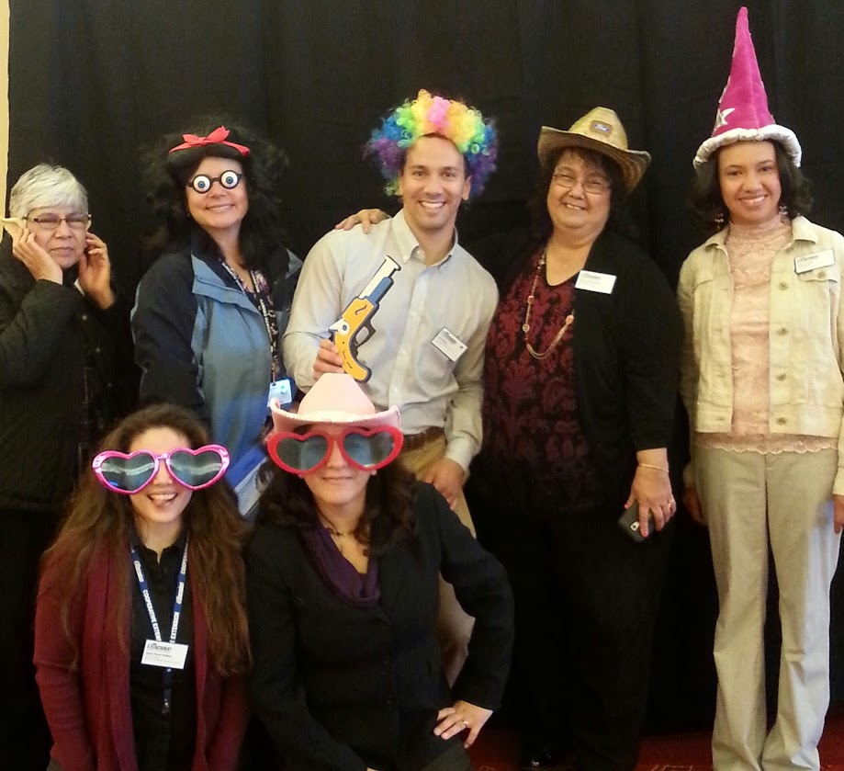
UWEX Latino Employees Resources Group
(LERG)
What our group is involved in:
Six-County Latino Study
Poster session at 2015 Transforming Today’s Extension for Tomorrow’s Possibilities
Translation and Interpretation Implementation Committee
2016 Regional Presentations to the Southwest and East-Metro conferences

Slide 4
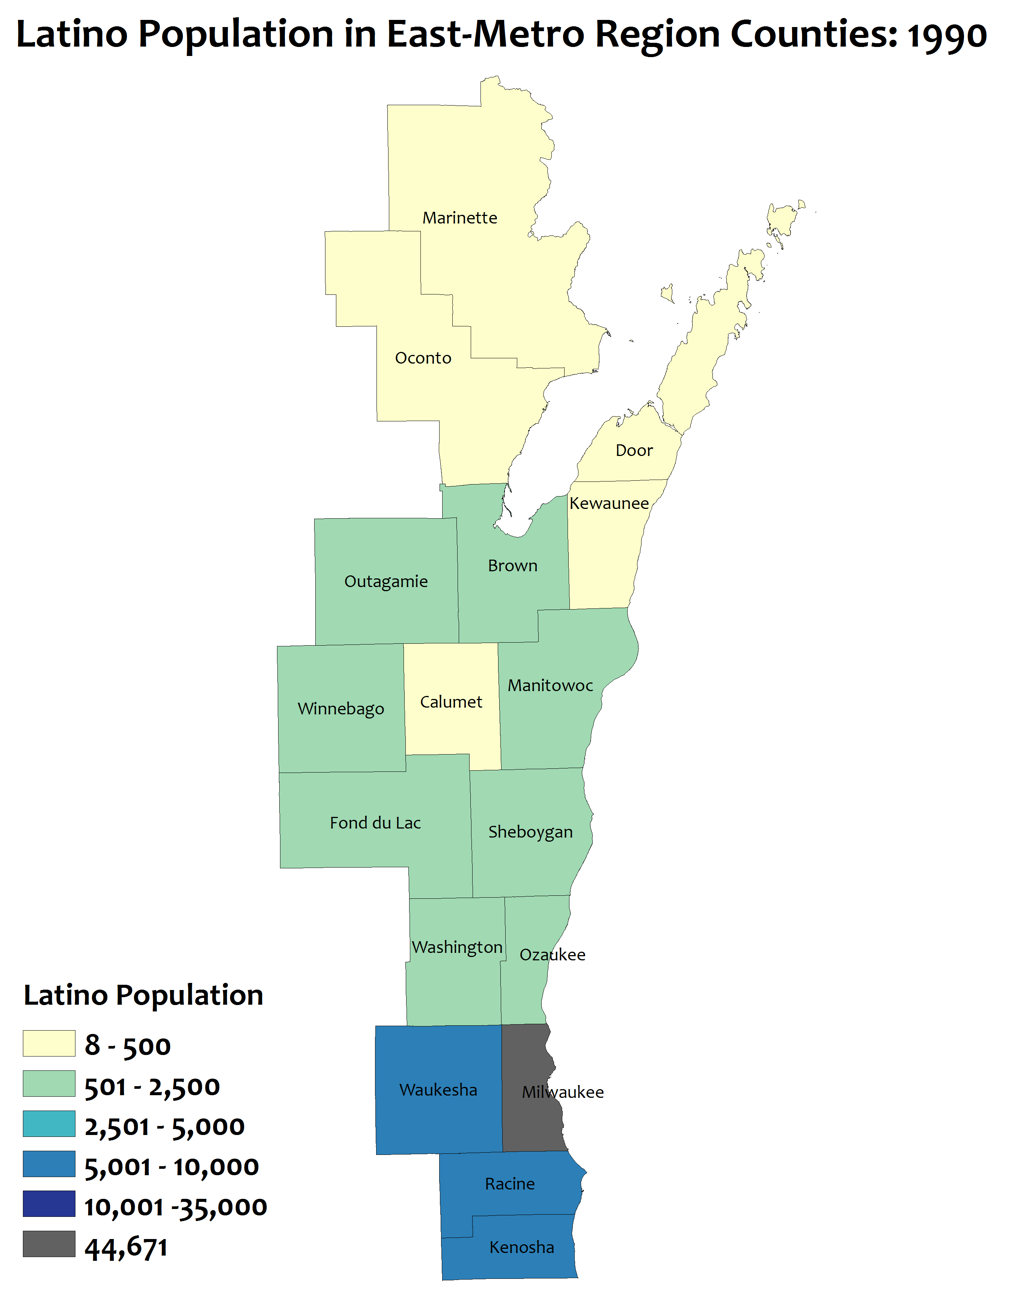
Rapid Latino population
growth: 1990
1990 total for region = 73,382
Notes:
Total Latino Population in East-Metro Region counties
Map shows total Latino population by county for EM region counties. The blue and darker blue represent higher total populations while the yellow or green represent lower populations. Milwaukee County is grey because it has a much larger Latino population than any other county
As you advance through the decades, more counties turn green or blue. Milwaukee County will turn red in the last map, again to show that its Latino population is so much larger.
This map is 1990. 12 of the counties in the region have more than 500 Latinos

Slide 5
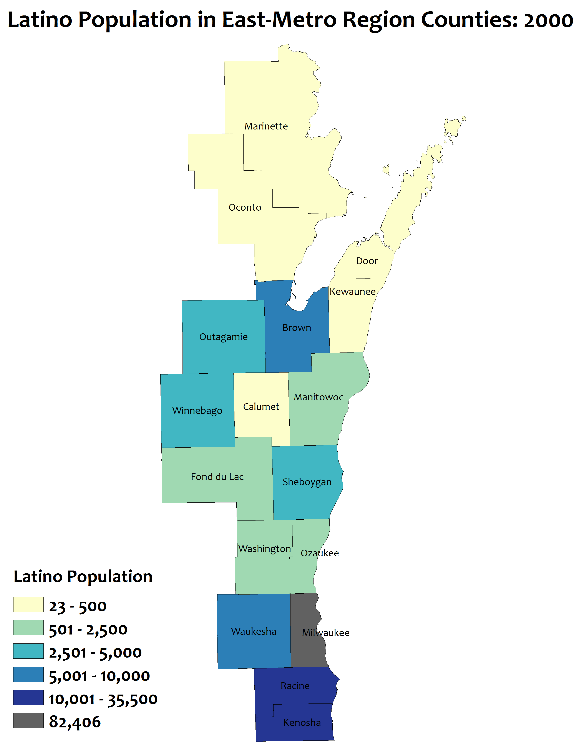
Rapid Latino population
growth: 2000
1990 total for region = 73,382
2000 total for region = 143,767
Notes:
This map is 2000. A lot of Latino population increase in Brown, Racine, and Kenosha and in the Fox Valley.
In 2000, 12 counties have more than 500 Latinos and 8 counties have more than 2,500 Latinos

Slide 6
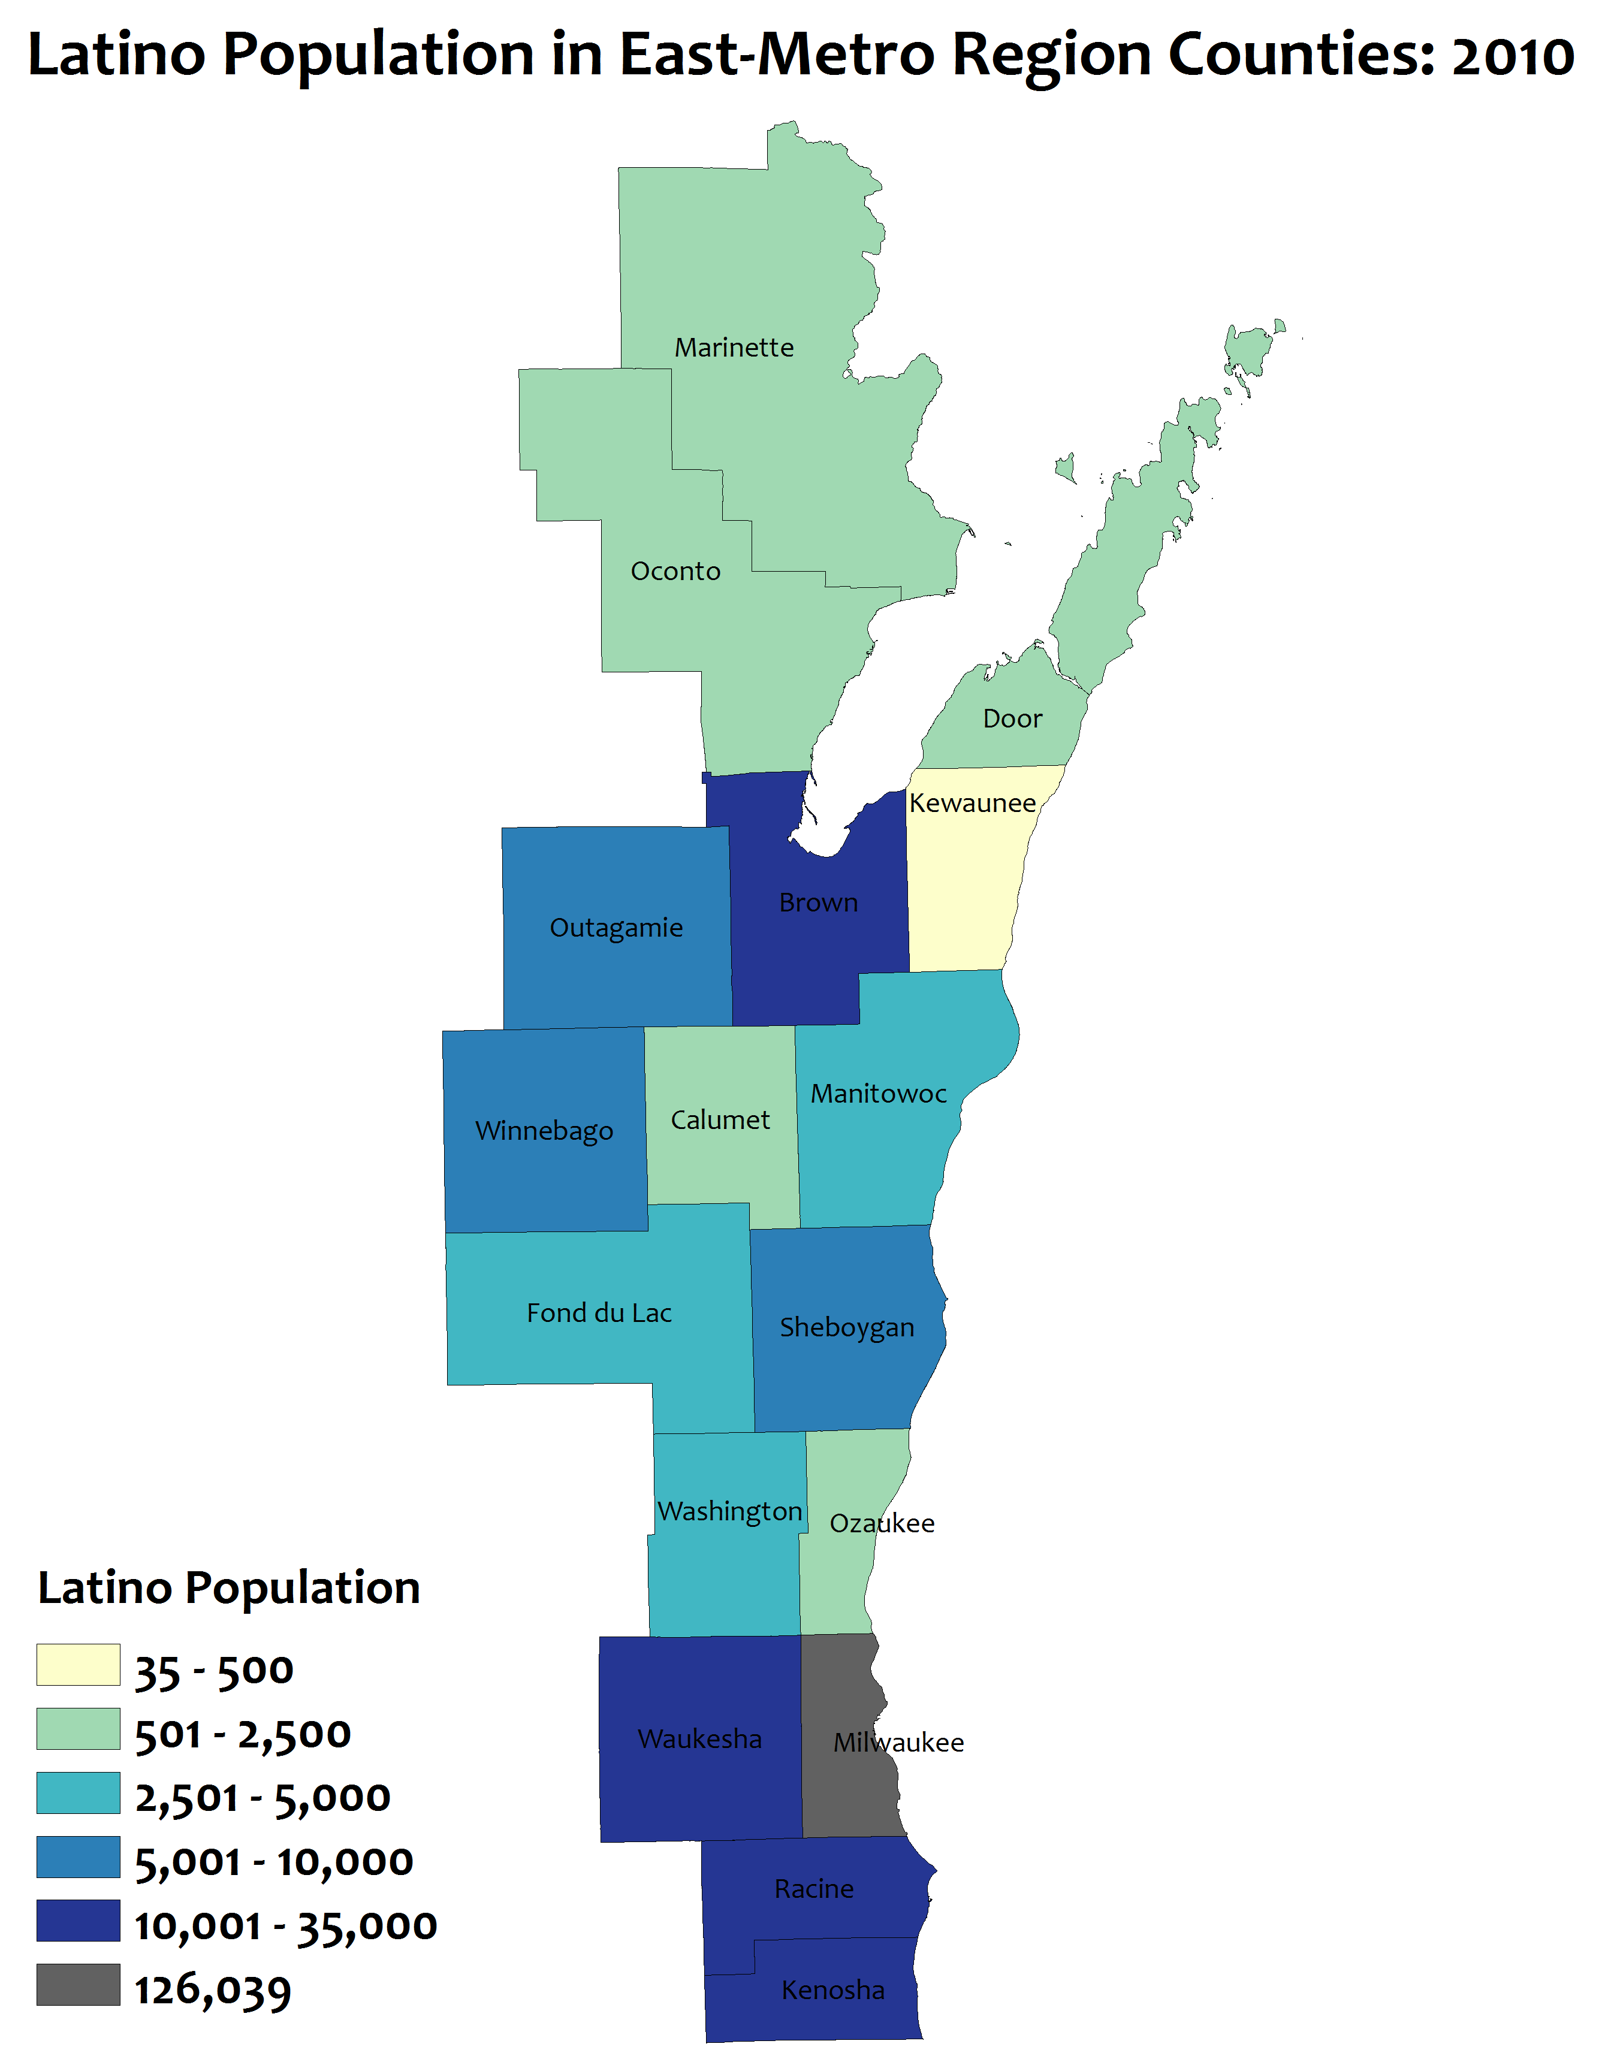
Rapid Latino population
growth: 2010
1990 total for region = 73,382
2000 total for region = 143,767
2010 total for region = 236,896
Notes:
Total Latino Population in East-Metro Region counties
This map is 2010. Lots of increase in all counties. 16 of the 17 counties in the region have more than 500 Latinos and 5 have more than 10,000 Latinos

Slide 7
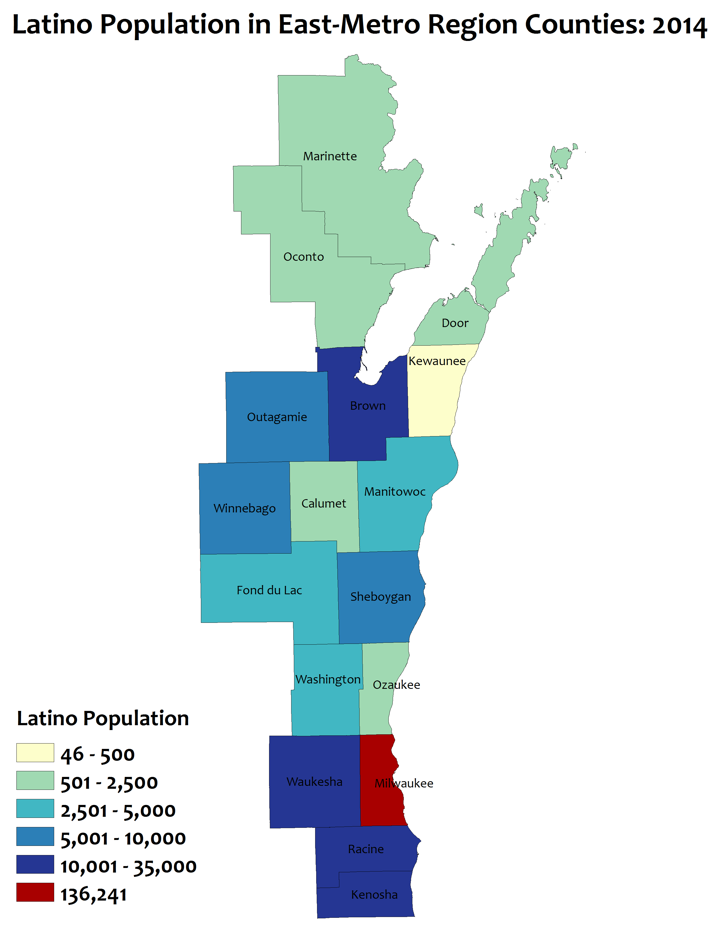
Rapid Latino population
growth: 2014
1990 total for region = 73,382
2000 total for region = 143,767
2010 total for region = 236,896
2014 total for region = 259,912
Notes:
Total Latino Population in East-Metro Region counties
This map is 2014 (the most recent data available). 16 of the 17 counties in the region have more than 500 Latinos. The combined population for the 17 counties has risen to almost 260,000
Latino population has gone from about 73,000 in 1990 to about 260,000 in 2014 – an increase of 187,000 (254%). In other words, the Latino population has more than tripled over a 25 year period.
The rate of growth is faster than the state as a whole.
Almost half of Latinos in the EM Region live in Milwaukee County. More than ¾ of Latinos in the region live in Milwaukee, Waukesha, Kenosha, and Racine.
About 70% of Wisconsin’s Latinos live in the EM Region counties.

Slide 8
The Latino population is very young
110,570 were under age 20
100,234 were age 20-44
Notes:
Population by Age
This chart compares the Latino population to the total population for major age groupings for the East-Metro Region counties. The Latino population is much, much younger than the total population. The green columns are the total population and the blue columns are the Latino population.
About 2 out of 5 Latinos in the region are under the age of 20.
More than 80% are age 44 and under.
Two extra clicks will bring in the boxes showing the number totals.

Slide 9
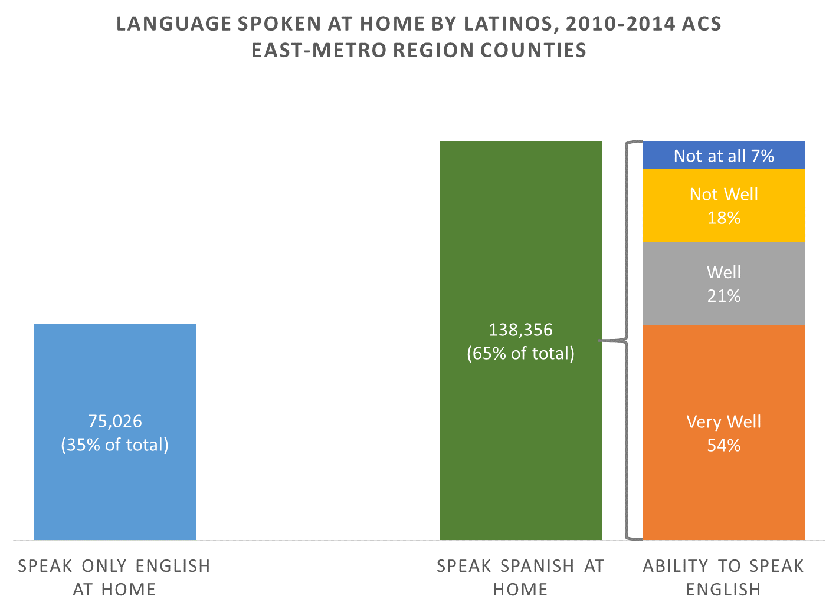
Many Latinos speak Spanish and English
For those who speak Spanish at home….
Notes:
Language spoken at home for Latino population age 5 and over
This chart shows data on language spoken at and ability to speak English for Latinos age 5 and over in the East-Metro Region counties.
Just over 1/3rd of Latinos in the EM Region counties speak only English at home.
About 75% of Latinos who speak Spanish at home also speak English “well” or “very well”
Data comes from the 2010-2014 American Community Survey 5-year estimates. All estimates in the ACS are based on survey responses and so language spoken at home and ability to speak English are self-reported by respondents.

Slide 10
UWEX Latino Employees Resources Group (LERG)
Time to share
Latinos and non-Latino educators working with Latinos or other ethnic groups please share your outreach strategies

Slide 11
Some suggestions for successful outreach with Latino Population:
Make a commitment
Emphasize Relationships over tasks
Employ Bilingual/Bicultural Staff and/or train and support staff
Access resources
Involve youth and families when planning programs
Create programs that reflect the Hispanic and Latino Culture and create a comfortable and welcoming learning environment.
Work with community partners
UWEX Latino Employees Resources Group (LERG)

Slide 12
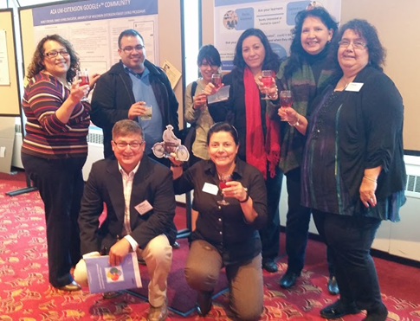
UWEX Latino Employees Resources Group (LERG)
Muchas Gracias
Workshop presenters: Araceli Oswald, Liliana Ramirez-Gonzalez,
and Eloisa Gómez.
Special thanks to Dan Veroff from: Applied Population Laboratory

