Slide 1
Effect of Wheel Traffic on Alfalfa Dr. Dan Undersander University of Wisconsin
Notes:
Traffic Studies – intro.

Slide 2
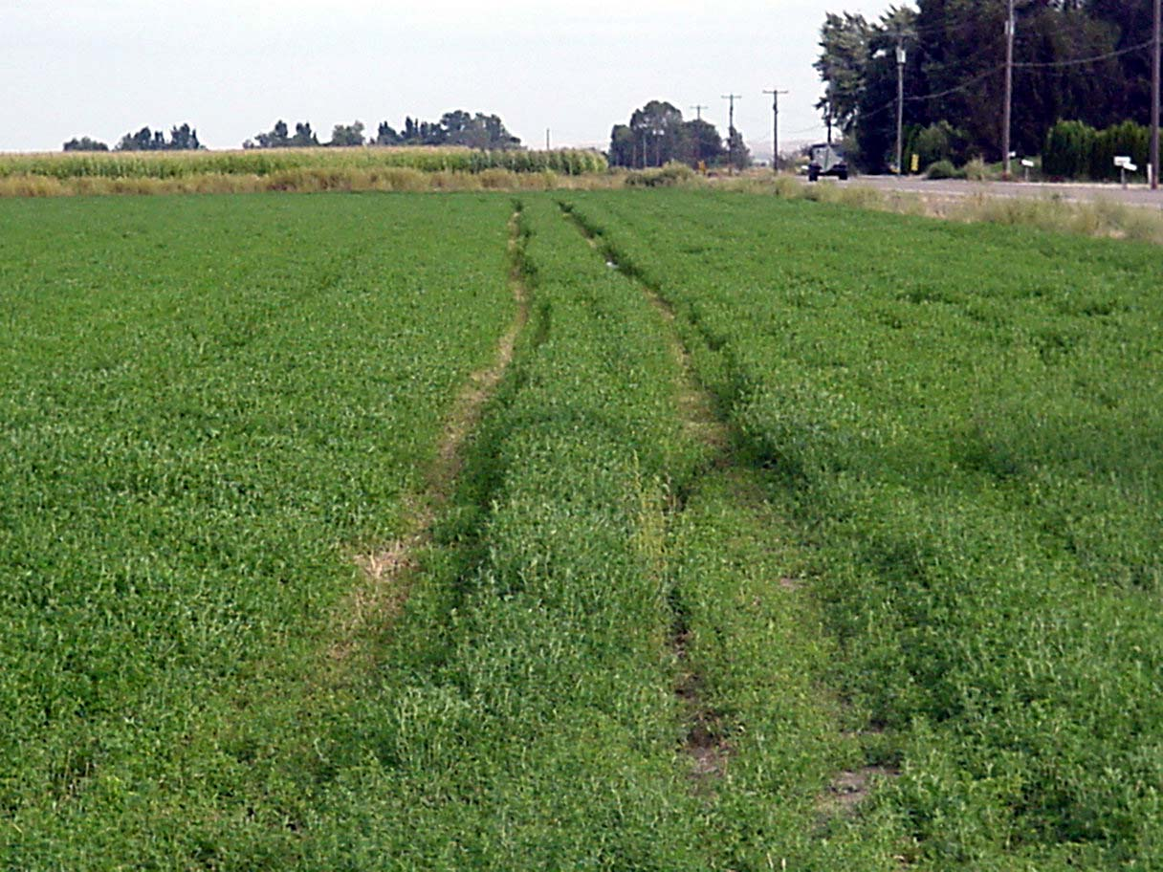
Wheel traffic damage from driving on wet field
Notes:
Wheel evidence, have always recognized that some damage occurs when harvesting field too wet, but damage occurs all the time.

Slide 3
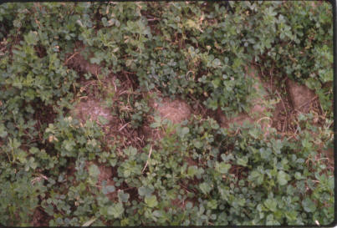
Alfalfa damaged in by tractor wheel lugs

Slide 4
Multi-State wheel traffic study
Plots with no traffic, 2-day or 5-day traffic
100% of plot covered twice per cutting
States participating
Iowa
Kentucky
Minnesota
New York
South Dakota
Wisconsin

Slide 5
Bulk density after 2 years

Slide 6
Effect of wheel traffic on alfalfa yield
Notes:
Average yield across 6 states

Slide 7
Effect of wheel traffic on 2-year yield
Pick highest yielding variety!
Percent yield loss only important to developers

Slide 8
Effect of wheel Traffic on Stem/ft²

Slide 10
Yield loss over 2 years
5-day
2-day

Slide 11
Managing to Reduce Wheel Traffic Loss
Minimize driving on field
Use smallest tractor for equipment
Merge windrows where possible
Go to larger equipment

Slide 12
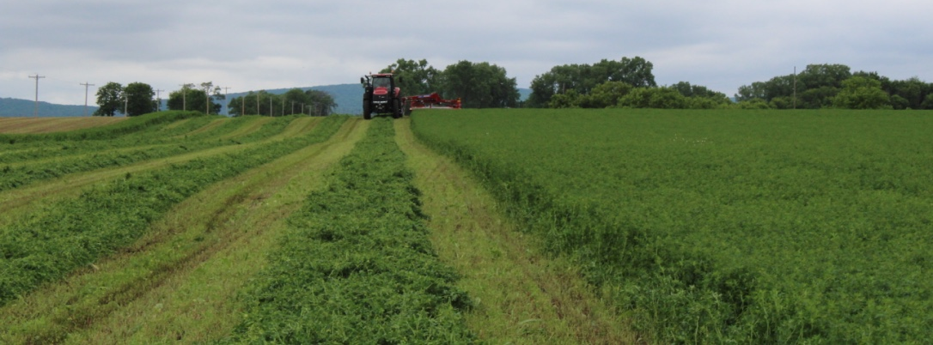
Cutter bar width effect on wheel traffic

Slide 13
Percentage of field covered with wheel traffic during harvesting
Mowing
10’ mower
Two tractor tires (20’’) and two mower tires 15’ = 70”/120” = 58%
Raking/merging
If 10’
58%
If 20’
29%
Baling/chopping
29% plus traffic to haul wagon/truck or bales off field
% trafficked
58 58
58 29
29 29
145 116

Slide 14
Percentage of field covered with wheel traffic during harvesting
Mowing
13’ mower
Two tractor tires (20’’) and two mower tires 15’ = 70”/192” = 44%
Raking/merging
If 13’
44%
If 26’
22%
Baling/chopping
22% plus traffic to haul wagon/truck or bales off field
% trafficked
44 44
44 22
22 22
110 88

Slide 15
Mowed swaths in pairs

Slide 16
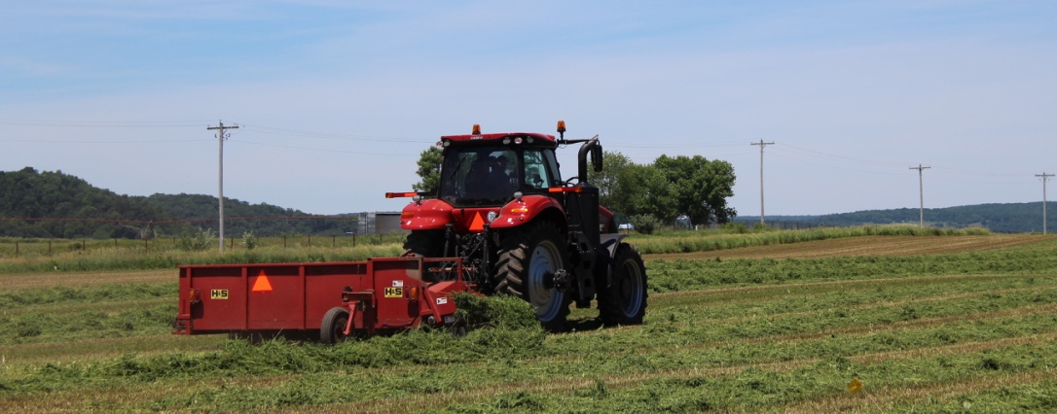
Merged two swaths into one windrow

Slide 17
Effect of cutter bar width on alfalfa yield
Year | Cutter bar width | Yield increase /year
2001 | 9’ vs 12’ | 0.5 t dm
2014 | 10’ vs 13’ | 0.5 t dm
2016 | 10’ vs 13’ | 1.0 t dm
Contract harvesting may benefit from use of larger equipment

Slide 18
Managing to Reduce Wheel Traffic Loss
Minimize driving on field
Use smallest tractor for equipment
Merge windrows where possible
Go to larger equipment
Take most direct route to edge of field
Make road to drive on

Slide 19
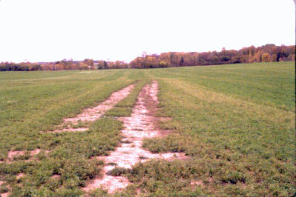
Farmer had trucks drive to flag and off field in same path

Slide 20
Managing to Reduce Wheel Traffic Loss
Minimize driving on field
Do driving on field soon after harvest
Manage to dry forage quickly
Harvest for haylage or baleage
Use preservative and harvest wet hay
Use of duals not recommended
Apply manure quickly after cutting

Slide 21
Summary
Wheel traffic can significantly reduce yield
Wheel traffic damage appears to be mainly due to plant damage.
Traffic longer after cutting does more damage
Genetic differences exist for traffic tolerance

Slide 22
