Slide 1
Storing Forage in Silage Piles
Jerry Clark
UW Extension Educator
Chippewa County
Dr. Brian Holmes
UW-Extension
Dept. Biological Systems
Engineering

Slide 2
Silage Piles-advantages
Short or long term storage
Inexpensive
Filling through Feedout Dry Matter Losses Less Than 21% with Good Management

Slide 3
Silage Piles-disadvantages
Dry matter losses greater than 50% without proper management
Space requirements
Possible distance from feeding area

Slide 4
Siting
Need all weather access
Best is concrete or asphalt slab
Macadam surface can work
Bare ground or macadam may lead to feed contamination
Macadam Drive

Slide 5
Siting
2% slope to allow rainfall and seep drainage
More than one pile
May form feeding center

Slide 6
Silage Piles – Long Term Feed Center Plan
N
100-
120
Commodity
Shed
260-
300
60
100-
120
Commodity
Bins
Dispose of
Drainage Properly

Slide 7
Silage Piles – Phase I
N
100-
120
Commodity
Shed
60
Commodity
Bins
Dispose of
Drainage Properly

Slide 8
Silage Piles – Phase II
N
100-
120
Commodity
Shed
260-
300
60
100-
120
Commodity
Bins
Dispose of
Drainage Properly

Slide 9
Silage Piles – Long Term Feed Center Plan
N
100-
120
Commodity
Shed
260-
300
60
100-
120
Commodity
Bins
Dispose of
Drainage Properly

Slide 10
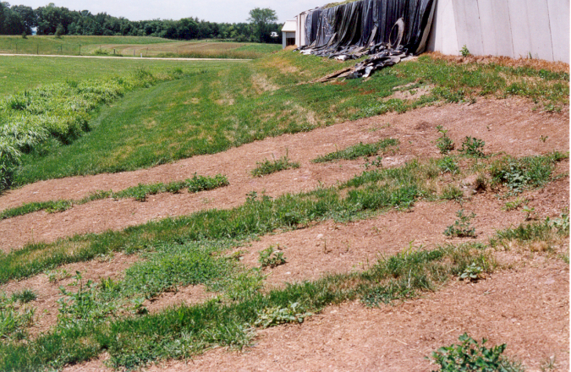
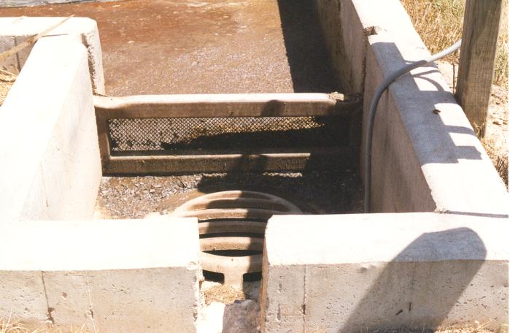
Siting -Wells
Effect of Seepage
Locate > 100 feet from well
Down slope from wells
Lighter soils – distance may be greater
Collect leachate and dispose properly
Settled Solids
Screen
Tank Inlet

Slide 11
Filling
3/8" to 3/4" theoretical length of cut
Better fermentation if cut short
Whole plant moisture
65-70% corn silage
60-65% hay silage
Bastiman 1976

Slide 12
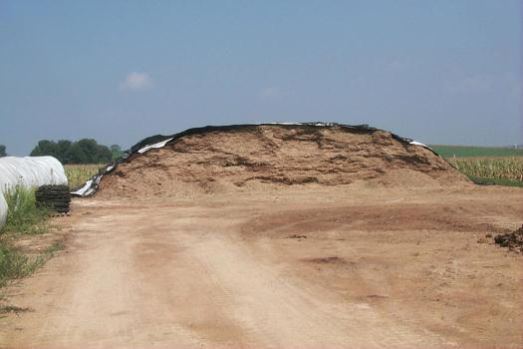
Filling
Progressive wedge technique
6” layer maximum
Side slope of 3:1 (horizontal:vertical)
Triangle cross section for small piles
Trapezoid cross section for larger piles
Pile height limited by reach of unloading equipment
Needs Shallower
Side Slopes

Slide 13
Packing
Pack! Pack! And Pack some more!!!

Slide 14
GO PACK!

Slide 15
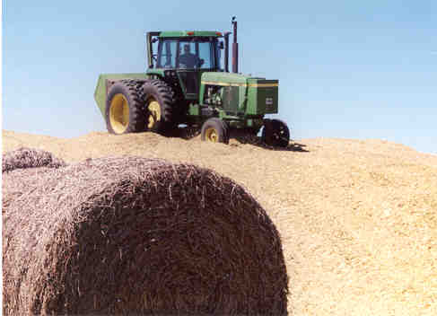
Packing
Packing Tractor
Shuttle shift
Roll over protection & seat belts
As heavy as possible
Duals add safety not necessarily better packing

Slide 16
Packing
Packing time
_ Multiple passes/multiple directions
5 minutes per ton of wet forage
½ hour before and after filling

Slide 17
Max. Packing Time – One Tractor

Slide 20
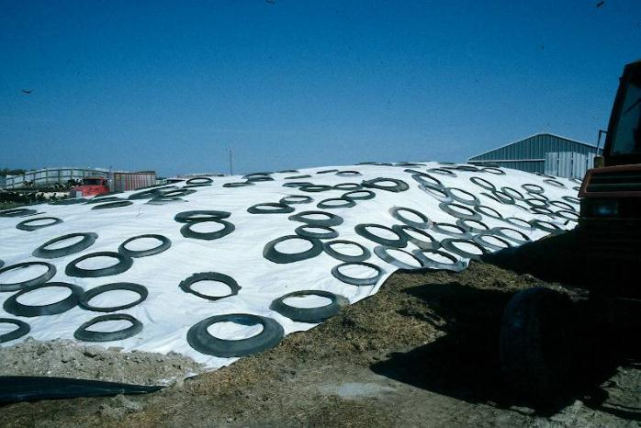
Covering
Cover as soon as possible
6 mil plastic
Tires touching each other
Seal edges
Needs More
Tires

Slide 21
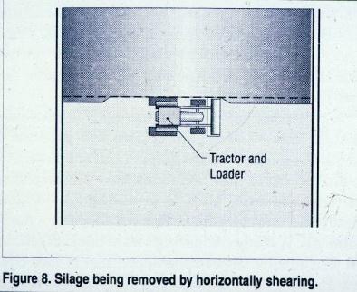
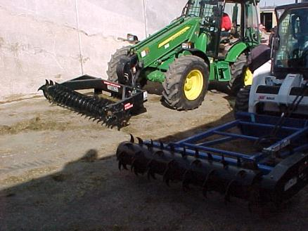
Feedout
Minimum 12 inches removal per day-minimizes spoilage
Keep Smooth Face –Consider Facer
Less can be fed out during winter

Slide 22
Feedout
360 ft - one year
or
180 ft
Example:
360 day feed storage period
Total Length of pile(s) should be 360 feet long, consider several piles
180 ft
or
120 ft
120 ft
120 ft

Slide 23
Summary
Inexpensive way to store forage
Direct expenses include pad, labor, packing & unloading equipment, plastic, fuel
Indirect expense is forage dry matter loss
$

Slide 24
Tips for Success
Harvest at correct moisture
Proper siting and construction
Thorough packing
Immediate covering
Proper feedout

